Slide 1

AmarCure: An AI-Powered Comprehensive Healthcare Management System
CSE299 | Section 03 | Group 03
Team Members:
Sajin Ahmed Nirjona | 2011108642 | Team Lead
Sadia Rahaman Piya | 2221136042 | Frontend Dev
Shahina Alian Mahifa | 2231167642 | UI/UX Designer
S.M. Rawnakul Islam Desh | 2233282642 | Backend Dev
MD. Tanvir Rahaman | 2232397042 | Database Engineer
Submitted to: Dr. Mohammad Shifat-E-Rabbi

Slide 2

Introduction & Objective
Project vision
AI insights
Bangladesh focus
Literature review
Market gaps
AmarCure solution
System architecture overview
Key features and modules
Target users and stakeholders

Slide 3
DocTime vs AmarCure
DocTime Strengths:
AmarCure Advantages:
Fast appointment booking
Live telemedicine consultations
Doctor profiles & ratings
OCR prescription scanning
AI-powered report analysis
Emergency health profile
Centralized EHR storage
Plain-language explanations
DocTime is strongest at connecting patients to doctors quickly, while AmarCure adds more support after the visit by organizing records and turning medical information into clear next steps. For users, that means DocTime helps with access, but AmarCure helps with continuity, comprehension, and long-term care management.

Slide 4
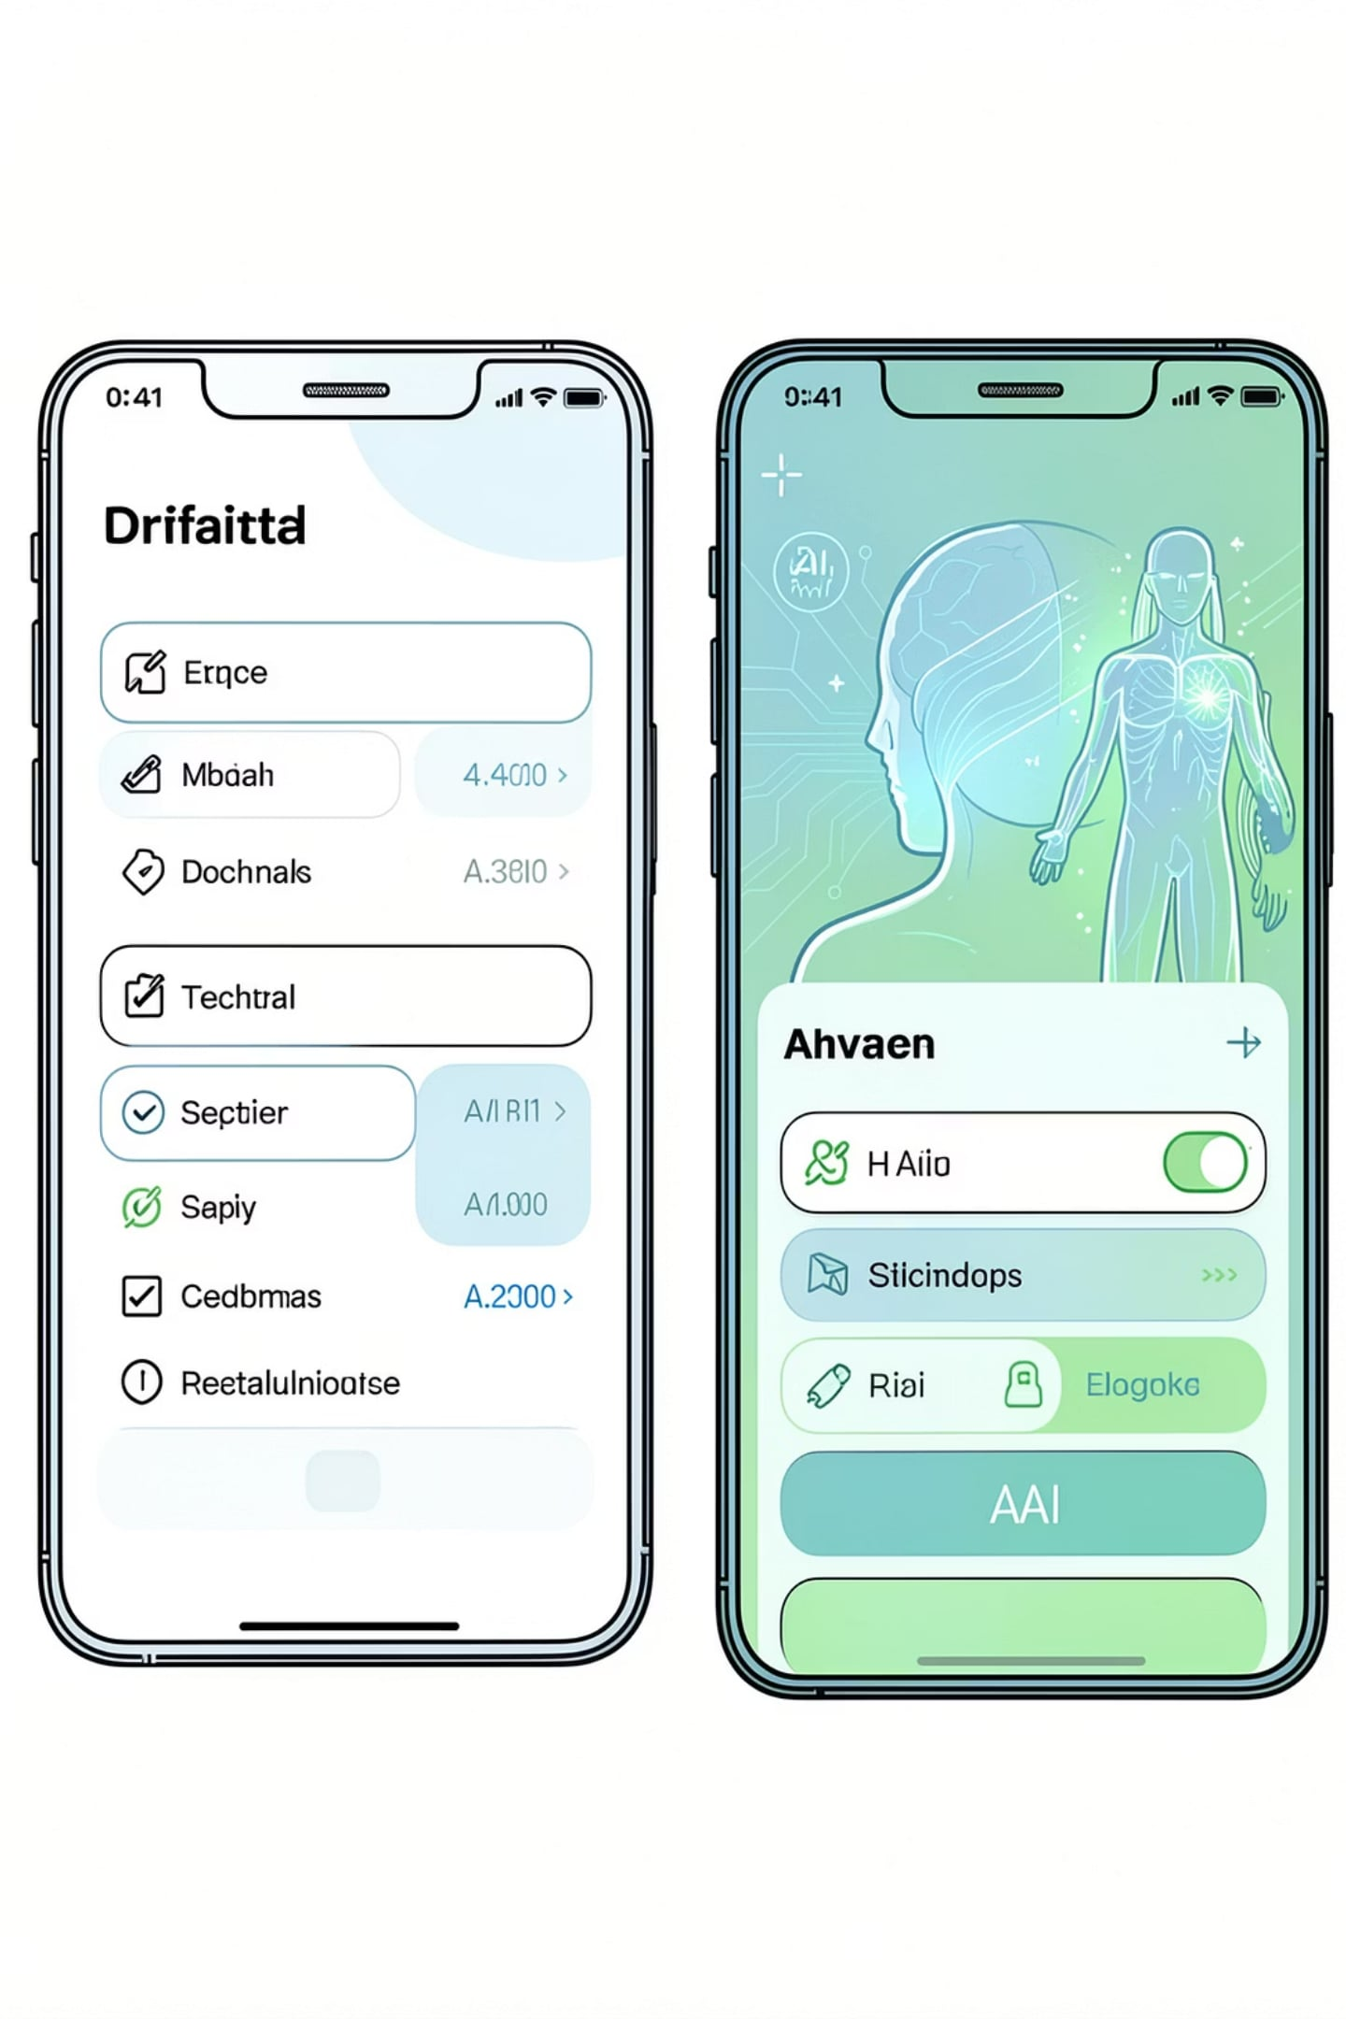
Shohoz Medical vs AmarCure
Shohoz Medical Strengths:
AmarCure Advantages:
Integrated medicine delivery
Appointment scheduling
Basic document upload
Advanced OCR extraction
AI-driven health insights
Prescription translation
Emergency access protocols
Multi-language support (Bengali/English)
These differences matter because they affect how easily patients can understand, act on, and safely manage their care. Shohoz Medical covers core service workflows, while AmarCure adds intelligence and accessibility features that reduce confusion, improve speed, and support more urgent or language-sensitive situations.

Slide 5
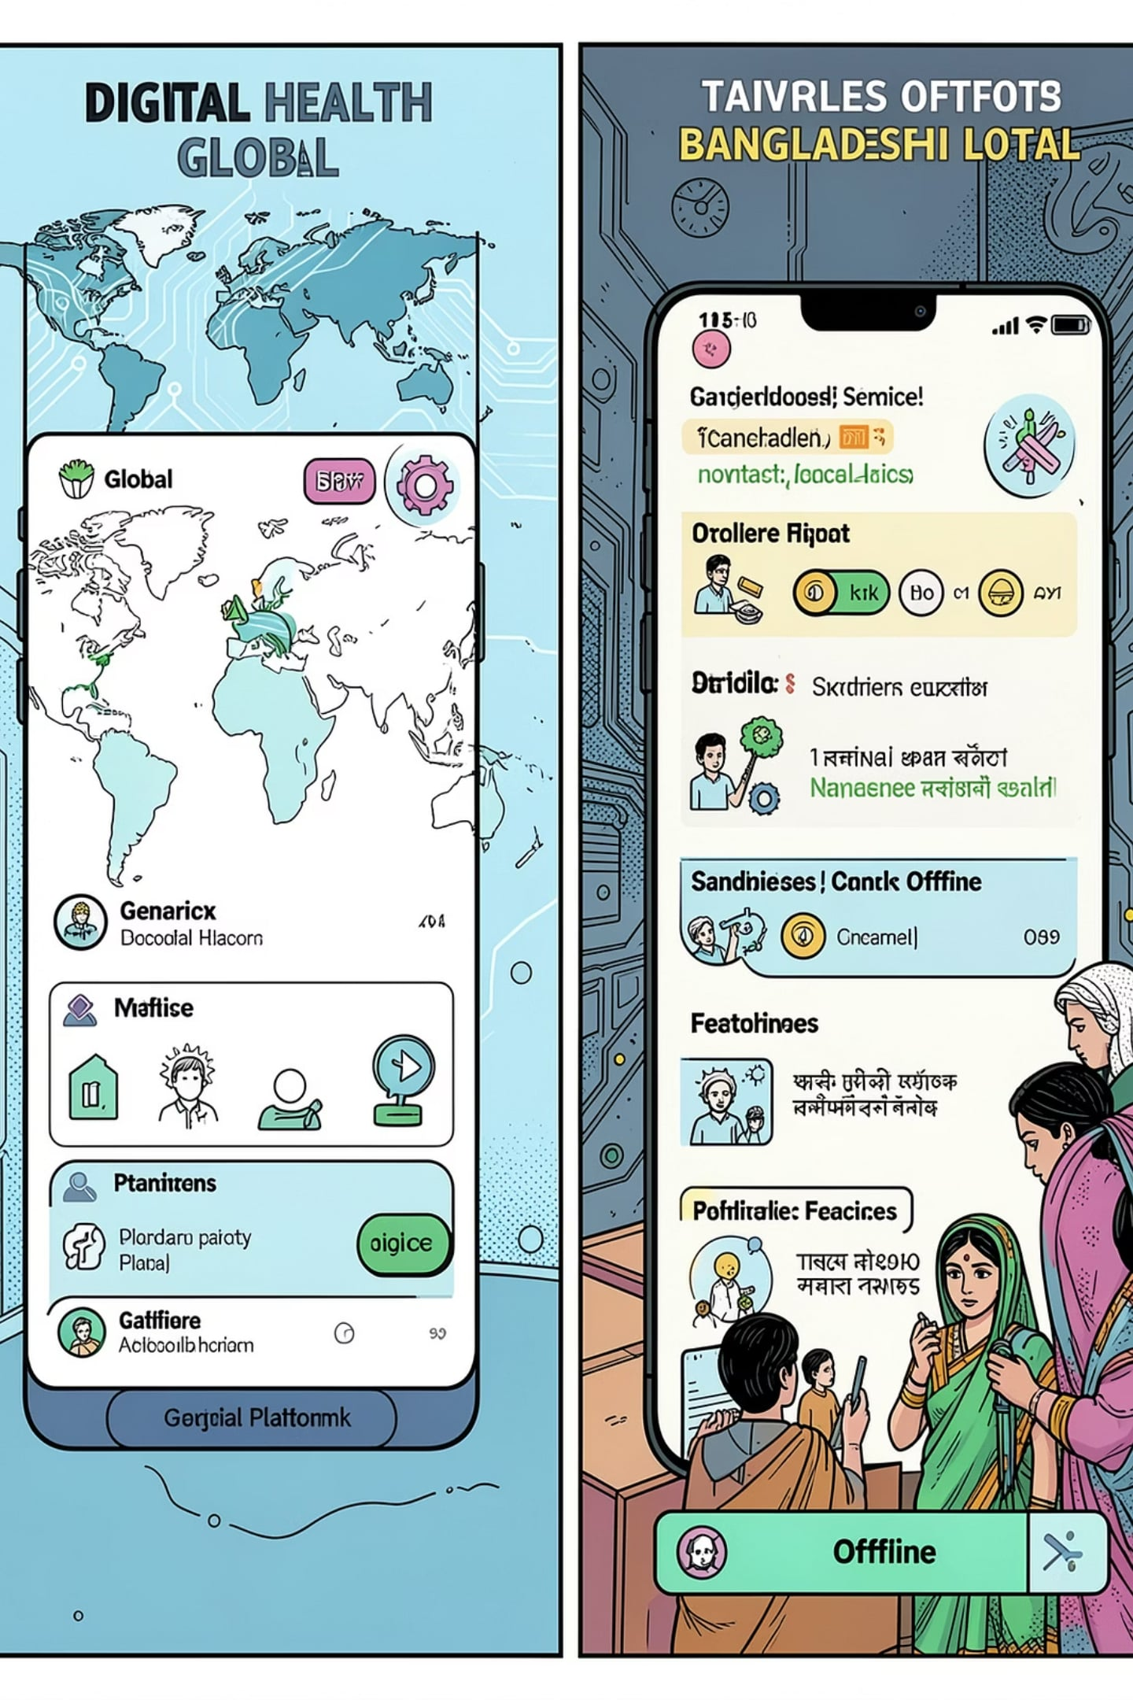
Ada Health vs AmarCure
Ada Health Strengths:
AmarCure Advantages:
AI symptom checker
Personalized health insights
Global reach & scale
Bangladesh-specific context
OCR document scanning
Report analysis & translation
Offline accessibility
Local healthcare integration
In practice, Ada Health is well suited for broad, general-purpose guidance, while AmarCure is designed around the realities of local care delivery. For users in Bangladesh, that means better document handling, language support, and access even when connectivity is limited.

Slide 6
Babylon Health vs AmarCure: A Comparative Analysis
Babylon Health Strengths:
AmarCure Advantages:
Comprehensive AI triage
24/7 digital consultations
Integrated health records
Prescription OCR & translation
Affordable for Bangladesh market
Emergency health profiles
Plain-language AI explanations
Accessible UX for all literacy levels
These differences matter because they shape who each platform serves best and how useful it is in real-world care. Babylon Health is built for broad digital healthcare access, while AmarCure is more focused on making prescription information understandable, affordable, and actionable for local users.

Slide 7

How Research Shapes AmarCure
Our product development is directly informed by critical analysis of existing solutions and market demands, ensuring AmarCure addresses real-world healthcare challenges.
DocTime gap
Built OCR prescription scanning
Shohoz limitation
Added AI-powered translation
Ada Health insight
Localized for Bangladesh context
Babylon gap
Designed for low-literacy accessibility
Market need
Emergency health profile feature
Integration issue
Centralized EHR storage system

Slide 8
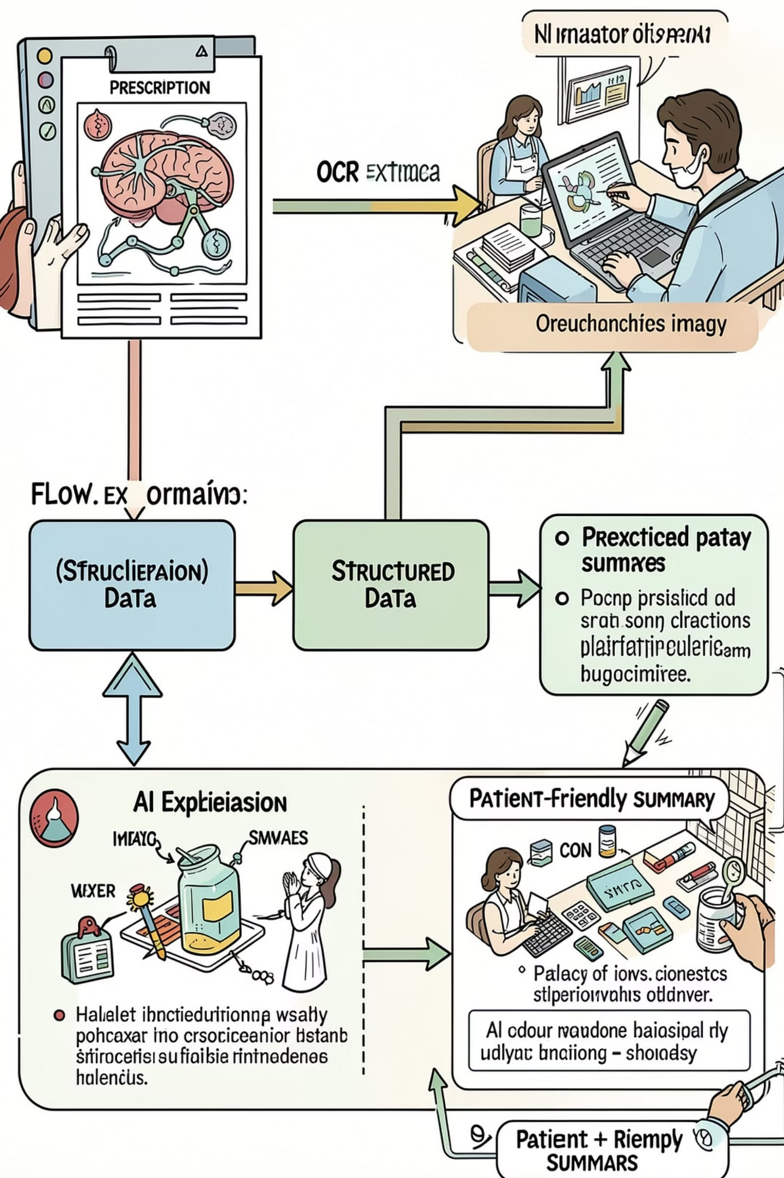
Proposed Core Workflow
Capture image: Snap a prescription or report photo
OCR extract: Pull text from the image automatically
Clean data: Fix formatting and remove noise
AI translate: Convert medical terms into simple language
Validate output: Check key fields for accuracy
Store EHR: Save the structured record securely
Generate summary: Share a patient-friendly explanation

Slide 9

Security, Scalability & UI Considerations
Data security
Scalability
Encrypt data
RBAC
Audit logs
Cloud storage
Microservices
Horizontal scale
Accessible UX
Plain language
BN/EN support
Emergency access

Slide 10

Conclusion & References
Conclusion:
Actionable insights
OCR extraction
Plain-language analysis
Bangladesh profile
References
World Health Organization (WHO). Global Strategy on Digital Health 2020–2025.
World Health Organization (WHO). Health and Care Workforce in Bangladesh.
International Telecommunication Union (ITU). Measuring Digital Development: Facts and Figures.
National Library of Medicine. Artificial Intelligence in Health Care: A Review.
DocTime, Shohoz
Ada Health, Babylon Health
IEEE, Springer

